Slide 1
Generic data types
Principles of programming

Slide 2
Introduction
In this section we will explain the concept of generic classes (generic data types, generics).
Before we begin, however, let’s look through an example that will help us understand more easily the idea.

Slide 3
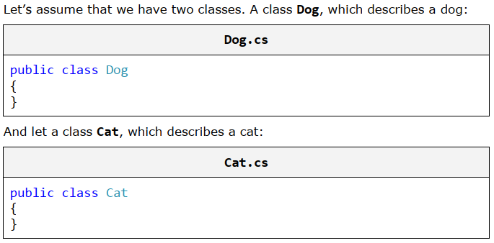
Shelter for Homeless Animals

Slide 4
Shelter for Homeless Animals
Then we want to create a class that describes a shelter for homeless animals – AnimalShelter.
This class has a specific number of free cells, which determines the number of animals, which could find refuge in the shelter.
The special feature of the class, that we want to create, is that it only needs to accommodate animals of the same kind, in our case, dogs or cats only, because the coexistence of different species is not always a good idea.
If we think about how to solve the task with the knowledge that we have until here, we will come to the following conclusion – to ensure that our class will contain elements only from one and the same type we need to use an array of identical objects.
These objects may be dogs, cats or simply instances of the universal type object.

Slide 5
Shelter for Homeless Animals
Live demo …

Slide 6
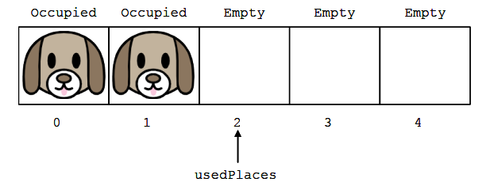
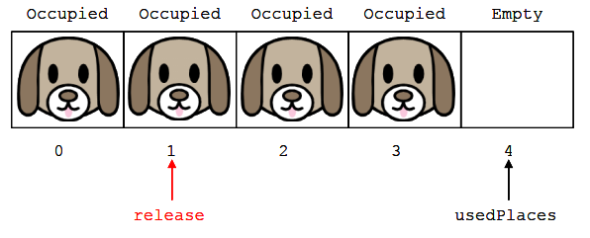
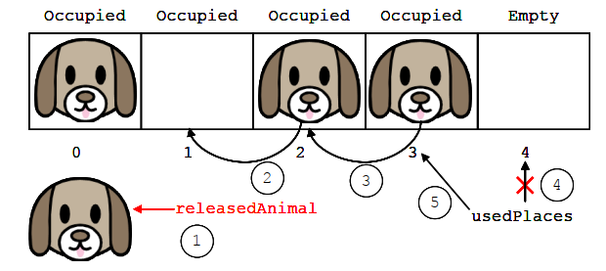
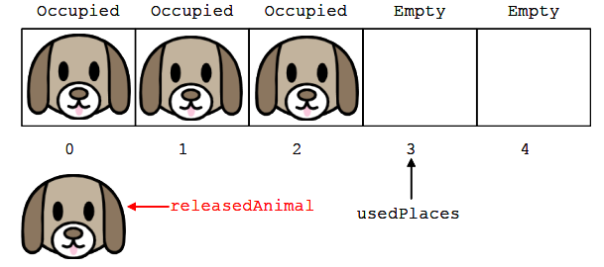
Shelter for Homeless Animals

Slide 7
Shelter for Homeless Animals
What happens, however, if we attempt to use an AnimalShelter class for objects of type Cat?
Consequently, if we want to create a shelter for cats, we will not be able to reuse the class that we already created, although the operations of adding and removing animals from the shelter will be identical.
Therefore, we have to literally copy AnimalShelter class and change only the type of the objects, which are handled – Cat.
Yes, but if we decide to make a shelter for other species?
How many classes of shelters for the particular type of animals we shall create?

Slide 8
Shelter for Homeless Animals
We could use instead of the type Dog, the universal type object, which can take values as Dog, Cat and all other data types, but this will create some inconvenience, associated with the need to convert back from the object to the Dog, when creating a shelter for dogs and it contains cells of type object, instead of type Dog.
To solve the task efficiently, we have to use a feature of the C# language that allows us to satisfy all required conditions simultaneously. It is called generics (template classes)

Slide 9
What Is a Generic Class?
If a method needs additional information to operate properly, this information is passed to the method using parameters.
During the execution of the program, when calling this particular method, we pass arguments to the method, which are assigned to its parameters and then used in the method’s body.
Like the methods, when we know, that the functionality (actions) encapsulated into a class, can be applied not only to objects of one, but to many (heterogeneous) types, and these types are not known at the time of declaring the class, we can use a functionality of the language C# called generics (generic types).
It allows us to declare parameters of this class, by indicating an unknown type that the class will work eventually with.
Then, when we instantiate our generic class, we replace the unknown with a particular.
Accordingly, the newly created object will only work with objects of this type that we have assigned at its initialization.
The specific type can be any data type that the compiler recognizes, including class, structure, enumeration or another generic class.

Slide 10
Typifying a class
Typifying a class (creating a generic class) means to add to the declaration of a class a parameter (replacement) of unknown type, which the class will use during its operation.
Subsequently, when the class is instantiated, this parameter is replaced with the name of some specific type.

Slide 11

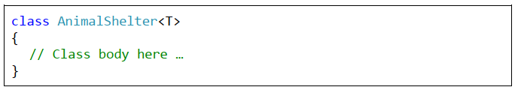
Declaration of Generic Class
Formally, the parameterizing of a class is done by adding <T> to the declaration of the class, after its name, where T is the substitute (parameter) of the type, which will be used later:

Slide 12
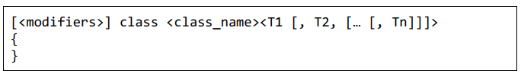
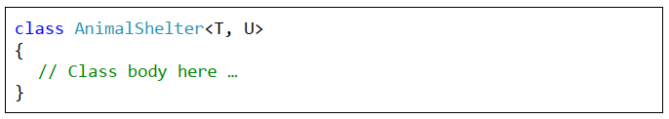
Declaration of Generic Class
A particular class may have more than one substitute (to be parameterized by more than one type), depending on its needs:
In case, we should to create a shelter for animals of a mixed type, one that accommodates both – dogs and cats, we should declare the class as follows:

Slide 13


Specifying Generic Classes
The using of generic classes should be done as follows:
If we want to create two shelters, one for dogs and one for cats, we should use the following code:

Slide 14
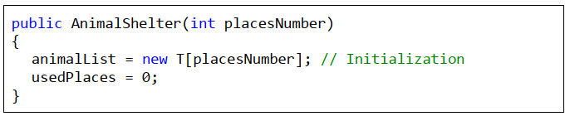
Using Unknown Types by Declaring Fields
Once used during the class declaration, the parameters that are used to indicate the unknown types are visible in the whole body of the class, therefore they can be used to declare the field as each other type:

Slide 15
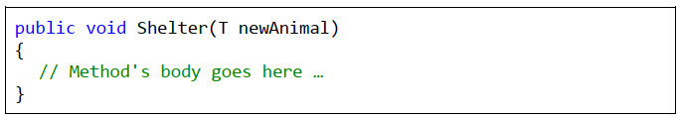
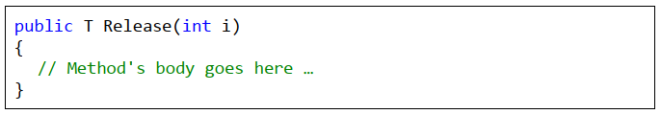
Using Unknown Types in a Method’s Declaration
As an unknown type used in the declaration of a generic class is visible from opening to closing brace of the class body, except for field’s declaration, it can be used in a method declaration
As a method of unknown type parameter T:
And a method, which returns a result of unknown type T:

Slide 16
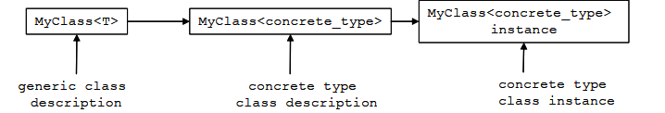
Typifying (Generics) – Behind the Scenes
What happens into the memory of the computer, when we work with generic classes.
First we declare our generic class MyClass<T> (generic class description in the scheme above).
Then the compiler translates our code to an intermediate language (MSIL), as translated code contains information that the class is generic, i.e. it works with undefined types until now. At runtime, when someone tries to work with our generic class and tries to use it with a specific type, a new description of the class is created (specific type class description in the diagram above), which is identical to the generic class, with the difference that where it has been used T, now is replaced by a specific type.
For example, if you try to use MyClass<int>, everywhere in your code, where the unknown parameter T is used, it will be replaced with int. Only then we can create object of a generic class with a specific type int.
The interesting thing here is that to create this object, the description of the class, which was created in the meantime (specific type class description), will be used.
Instantiating of a generic class by given specific types of its parameters is called "specialization of the type" or "extension of generic class".

Slide 17
Generic Methods
Like classes, when the type of method’s parameters cannot be specified, we can parameterize (typify) the method.
Accordingly, the indication of a specific type will happen during the invocation of the method, replacing the unknown type with a specific one, as we did in the classes.
Typifying of a method is done, when after the name and before the opening bracket of the method, we add <K>, where K is the replacement of the type that will be used later:

Slide 18
Generic Methods
Notice that in the list of parameters we have used also the keyword ref.
This concerns the specification of the method – namely, to exchange the values of two references.
By using the keyword ref, the method will use the same reference that was given by the calling method. This way, all changes on this variable made by our method, will remain after the method exits.
We should know that by calling a generic method, we can miss the explicit declaration of a specific type (in our example <int>), because the compiler will detect it automatically, recognizing the type of the given parameters.

Slide 19

Generic Methods
Simplify function call
Compiler will be able to recognize what is the specific type, only if this type is involved in the parameter’s list.
The compiler cannot recognize what is the specific type of a generic method only by the type its return value or if it does not have parameters.
In both cases, this specific type will have to be given explicitly.
In our example, it will be similar to the original method call, or by adding <int> or <string>.

Slide 20
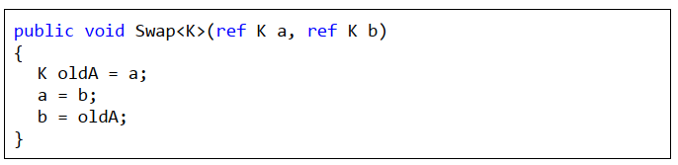
Generic Methods
Live demo …

Slide 21
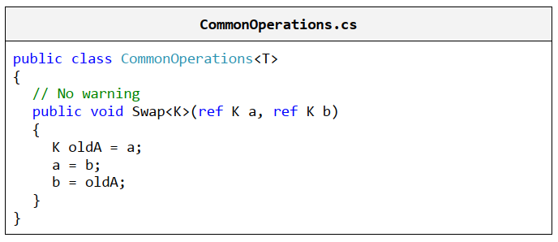
Declaration of Generic Methods in Generic Classes
If we want our code to be flexible, and our generic method safely to be called with a specific type, different from that in the generic class by instantiating it, we just have to declare the replacement of the unknown type in the declaration of the generic method to be different than the parameter for the unknown type in the class declaration

Slide 22

Keyword "default"
The problem with default values in generic variables is that we are trying to use the default value for a reference type (null), but we are not sure whether this type is a reference type or a primitive.
Therefore the compiler displays the errors above. If the type AnimalShelter is instantiated by a structure and not by a class, then the null value is not valid.
To handle this problem, in our code we have to use the construct default(T) instead of null, which returns the default value for the particular type that will be used instead of T.
We know, the default value for reference type is null, and for numeric types – zero.

Slide 23
Animal Shelter Generics
Live demo …

Slide 24
Advantages and Disadvantages of Generics
Generic classes and methods increase the reusability of the code, the security and the performance compared to other non-generic alternatives.
As a general rule, the programmer should strive to create and use generic classes, whenever it is possible.
The more generic types are used, the higher level of abstraction there is in the program and the source code becomes more flexible and reusable.
However we should keep in mind, that overuse of generics can lead to over-generalization and the code may become unreadable and difficult to understand by other programmers.

Slide 25
Naming the Parameters of the Generic Types
If there is just one unknown type in the generic, it is common to use the letter T, as a substitute for that unknown type. As an example we can give our class declaration AnimalShelter<T>, which we used until now.
To the substitutes should be given the most descriptive names, unless a letter is not a sufficiently descriptive and well-chosen name, this will not improve readability of the source code. For instance, we can modify our example, replacing the letter T, with the more descriptive substitute for Animal
When we use descriptive names of substitutes instead of a letter, it is better to add T at the beginning of the name, to distinguish it more easily from the class names in our application. In other words, instead of using a substitute Animal in the previous example, we should use TAnimal (T comes from the word "template" which means a parameterized / generic type).

Slide 26
Exercises
Write a generic class GenericList<T>, which holds a list of elements of type T. Store the list of elements into an array with a limited capacity that is passed as a parameter of the constructor of the class. Add methods to add an item, to access an item by index, to remove an item by index, to insert an item at given position, to clear the list, to search for an item by value and to override the method ToString().
Implement auto-resizing functionality of the array from the previous task, when by adding an element, it reaches the capacity of the array.
We have a school. In school we have classes and students. Each class has a number of teachers. Each teacher has a variety of disciplines taught. Students have a name and a unique number in the class. Classes have a unique text identifier. Disciplines have a name, number of lessons and number of exercises. The task is to shape a school with C# classes. You have to define classes with their fields, properties, methods and constructors. Also define a test class, which demonstrates, that the other classes work correctly.

